Slide 1
TITLE: REAL TIME SPEECH TRANSLATOR (USING PYTHON )
TEAM MEMBERS:
2010030313 -NAVADEEP REDDY
2010030502-VIPUL REDD
2010030503-MANOJ
2010030475-SIDDARTHA

Slide 2


Table of Contents
ABSTRACT
INTRODUCTION
FLOW CHART
Literature REVIEW
METHADOLOGY AND ALGORITHM
DATASETS
IMPLEMENTATION&RESULTS
CONCLUSION&FUTURE WORK
Thank you

Slide 3

ABSTRACT:
In today’s world language translation is very important, because if any person attends a global meeting/conference the language might be different from what is known, at that time speech translation is very useful. Speech translator is mediator between two languages. In this we have reviews various issues related to Speech translation as well as various difficulties in it. The purpose of this paper is to develop a speech translator that can recognize initial language spoken and can translate from one language to other languages sentence by sentence.
I believe that these kinds of developments are making our lives simpler. Area where real-time speech translation can be helpful is in online lectures, while listening to the instructor we can translate to the language we are comfortable with.
This feature will make the learning process easier. This is just a basic example; I am sure there are many
crucial areas where real-time speech translation can be implemented

Slide 4
INTRODUCTION:
Speech-to-Speech Translation aims at translating a source speech signal into a target speech signal.
Word translation
The first translation systems identify one-to-one associations between words of target and source
languages.
Phrase translation
The human translation is a very complex process which is not only word-based.
Language model
A language model has an important role in a statistical machine translation.
Decoding
The translation issue is treated as an optimization problem. Translating a sentence from English into a
foreign language involves finding the best foreign target sentence

Slide 5
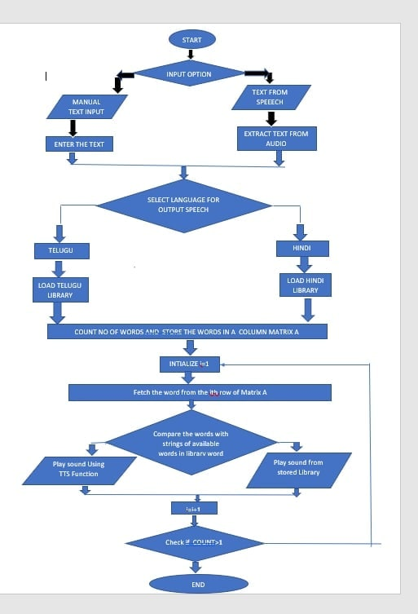
FLOWCHART

Slide 6

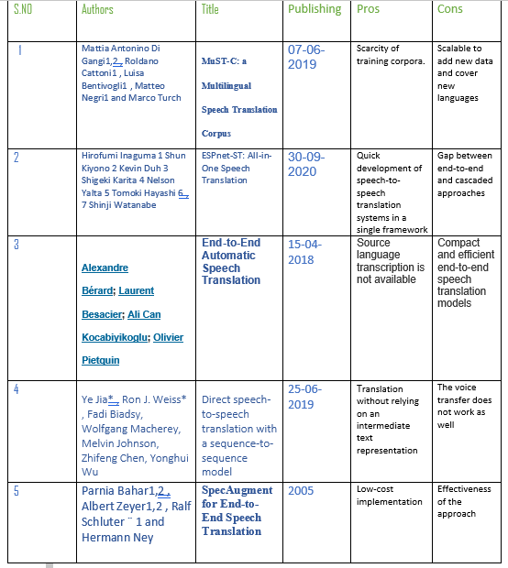

LITERATURE SURVEY

Slide 7
Literature survey
The Voice/speech translation system integrates two technologies : Automatic Speech Recognition, Machine Translation. The speaker of language A speaks, and the speech recognizer recognizes the utterance. The input is then converted into a string of words, using dictionary and grammar of language A, by using the massive corpus of text of language A.
HMMs are mostly used in speaker recognition today. We get the output sequence of symbols from these models. HMMs are used in speech recognition because the audio signal can be considered piece wise stationary signal.
Neural Networks has come up as nice approach for acoustic modelling in ASR since 1980s. In contract to HMMs, neural networks does not make any assumptions regarding the statistical properties and have several qualities that make them great model for speech recognition.

Slide 8
LITERATURE SURVEY
Most of the data that we find is from different domains. For example, the texts that are used in the chat rooms are different than those used in the parliaments. The problem in the Neural machine translation can be that it is trained on the data that is not at relevant to the user and hence not getting correct translations. This problem is called as Domain Adaptation.
Speech translation is conventionally carried out by cascading an Automatic Speech Recognition System and Machine Translation system. Generally, the factors that are optimized are the language models and the acoustic models along with the word error rate for the ASR system and the BLEU score for the MT system.

Slide 9
METHODOLOGY & ALGORITHMS
Tkinter – python GUI programming tool
Tkinter is a library written in Python that is widely used to create GUI applications. It is very easy to build
GUI using Tkinter and the process is even faster and has several widgets that can be used while developing
GUI. These include buttons, radio buttons, checkboxes, etc.
Here we will be using the CVSS Data set that is available on Kaggle

Slide 10
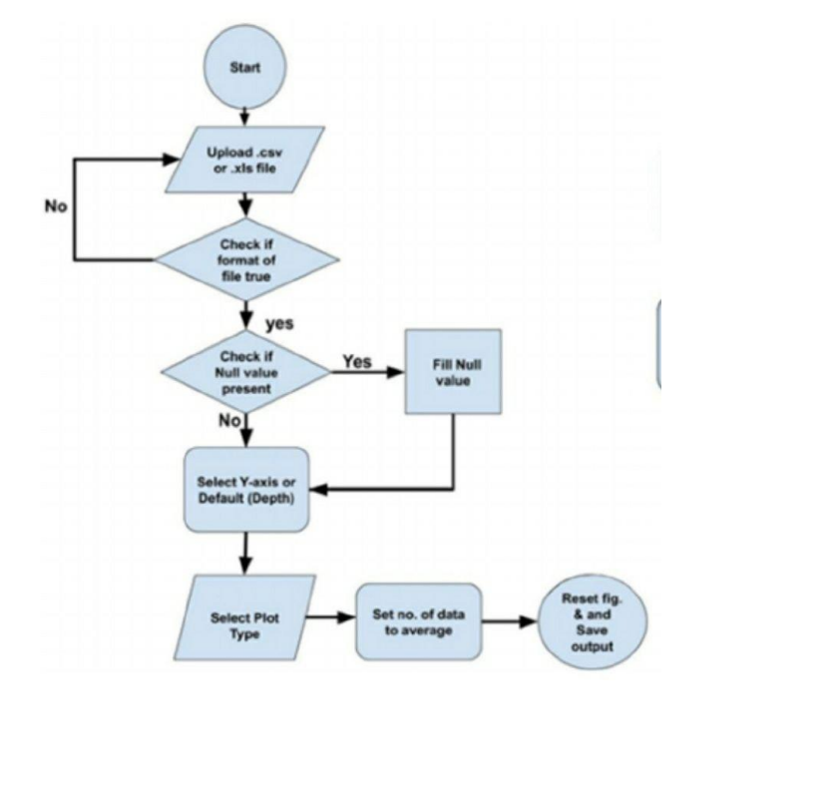

Slide 11
DATASETS
Datasets | Characteristics
CVSS | CVSS is a multilingual-to-English speech to speech translation corpus, covering sentence-level parallel S2ST pairs from 21 languages into English. CVSS is derived from the Common Voice speech corpus and the CoVoST 2 speech-to-text translation (ST) corpus, by synthesizing the translation text from CoVoST 2 into speech.
MuST-C | MuST-C currently represents the largest publicly available multilingual corpus (one-to-many) for speech translation. It covers eight language directions(English to German, Spanish, French, Italian, Dutch, Portuguese, Romanian and Russian). The corpus consists of audio, transcriptions and translations of English TED talks, and it comes with a predefined training, validation and test split.
MaSS | MaSS (Multilingual corpus of Sentence-aligned Spoken utterances) is an extension of the CMU Wilderness Multilingual Speech Dataset, a speech dataset based on recorded readings. MaSS extends it by providing a large and clean dataset of 8,130 parallel spoken utterances across 8 languages. (The covered languages are: Basque, English, Finnish, French, Hungarian, Romanian, Russian and Spanish)

Slide 12
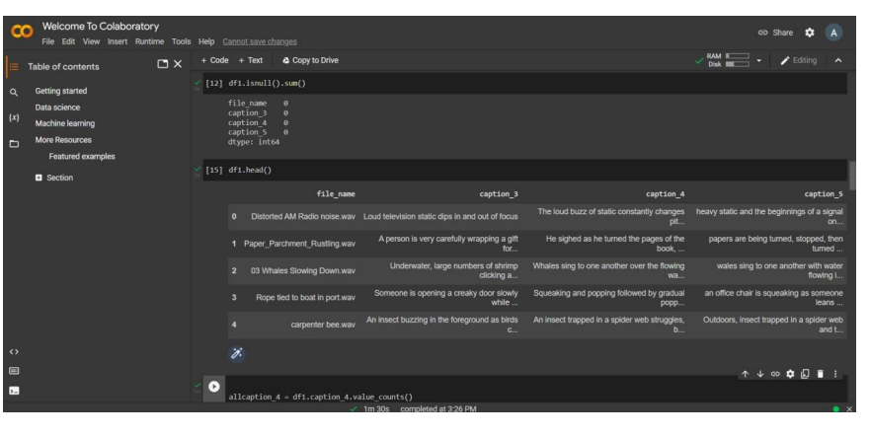
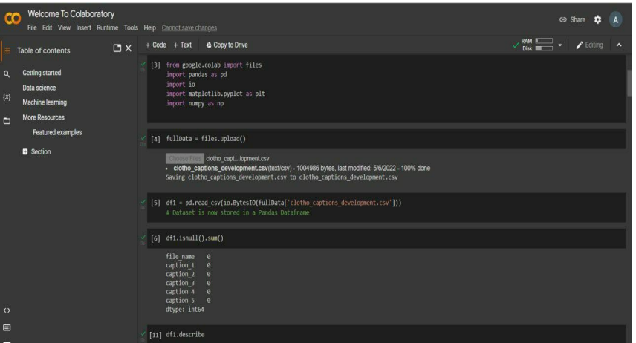

Slide 13
T E C H N I Q U E S
Datasets | TechniQues and models
CVSS | PnG NAT ii) PnG NAT with VC iii) Speaker Encoder
MuST-C | Bilingual vs. Multilingual Low-resource scenario Fine tuning
MaSS | LAS Network Architectures Learning Rate Schedules Shallow Fusion with Language Models

Slide 14
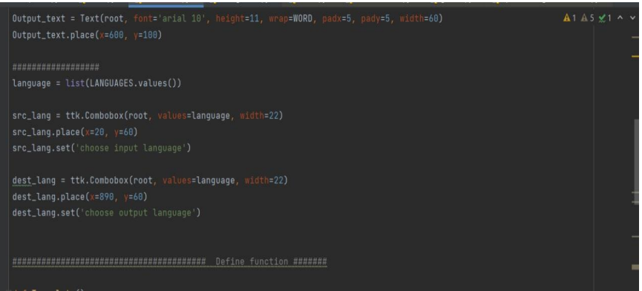
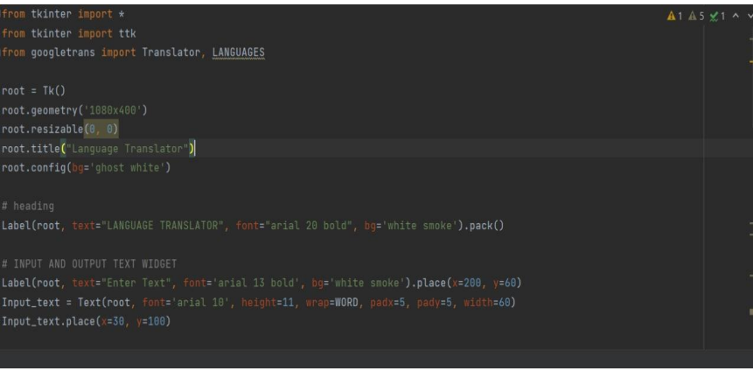
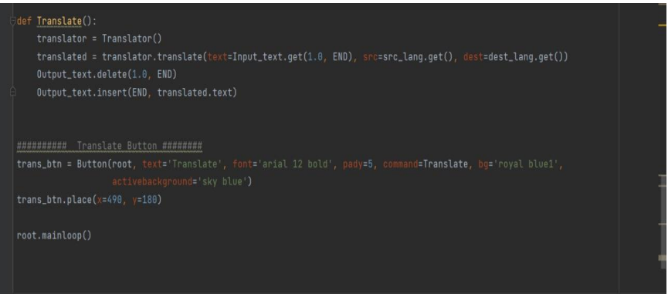
implementation and results

Slide 15
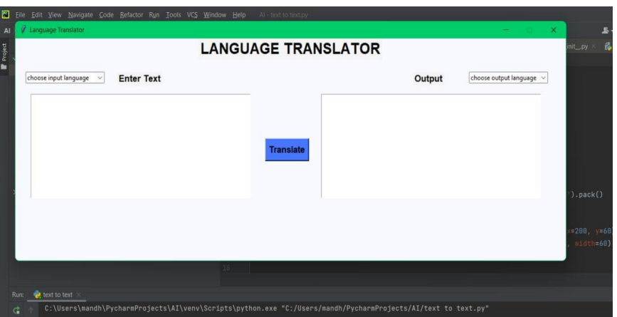

Slide 16
Humans can interact with each other through natural language. If both people understood their languages, then interaction between these two people is more complete. In this Speech translation system, there is no need of creation of database manually for matching/converting source text to destination text, due to this translation time will be reduced. From the comparison between techniques in speech recognition, Sphinx model is identified as one of the popular connectionist techniques and suitable to use in speech recognition. We plan to develop a multi-way translation like Hindi to English, Tamil and Telugu. Finally, the Real time voice translation system is done in this way.
CONCLUSION:

Slide 17
FUTURE SCOPE
The future, speech recognition may become speech understanding. The statistical models
that allow computers to decide what a person just said may someday allow them to grasp the meaning
behind the words. Although it is a huge leap in terms of computational power and software sophistication,
some researchers argue that speech recognition development offers the most direct line from the computers of today to true artificial intelligence. In our project we would like to completely develop and deploy speech translation feature along with sub-titles directly into live videos and speeches

Slide 18
REFERENCES :
[1]A. Lavie, A. Waibel, L. Levin, M. Finke, D. Gates, M. Gavalda, T. Zeppenfeld, and P. Zhan,
“JANUS-III: Speech-to-speech translation in multiple languages,” in Proc. ICASSP, 1997.
[2] W. Wahlster, Verbmobil: Foundations of speech-to-speech translation. Springer, 2000
[3]S. Nakamura, K. Markov, H. Nakaiwa, G.-i. Kikui, H. Kawai, T. Jitsuhiro, J.-S. Zhang, H.
Yamamoto, E. Sumita, and S. Yamamoto, “The ATR multilingual speech-to-speech translation
system,” IEEE Transactions on Audio, Speech, and Language Processing, 2006.
[4]International Telecommunication Union, “ITU-T F.745: Functional requirements for network_x0002_based speech-to-speech translation services,” 2016.
[5] H. Ney, “Speech translation: Coupling of recognition and translation,” in Proc. ICASSP, 1999

Slide 19

Suggestions

Slide 20
THANK YOU

